Slide 1
Utilizing and Adapting Synthetic Data for Pose Estimation of Occluded Humans in Horizontal Positions
Master’s Thesis
Atharva Suhas Vaidya, 416254
MSc. Robotic Systems Engineering

Slide 2

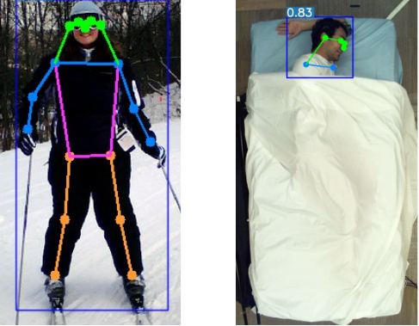
Pose Estimation of Occluded Humans in Horizontal Positions
Motivation
The presence of heavy occlusions severely affects the performance of SOTA models
Hard to estimate unconventional horizontal poses
Majority of the contactless sleeping pose estimation algorithms are based on IR or Depth images – need of sophisticated hardware
Synthetic Data
Hard to generate and annotate large datasets for in-bed or sleeping poses
Privacy concerns

Slide 3
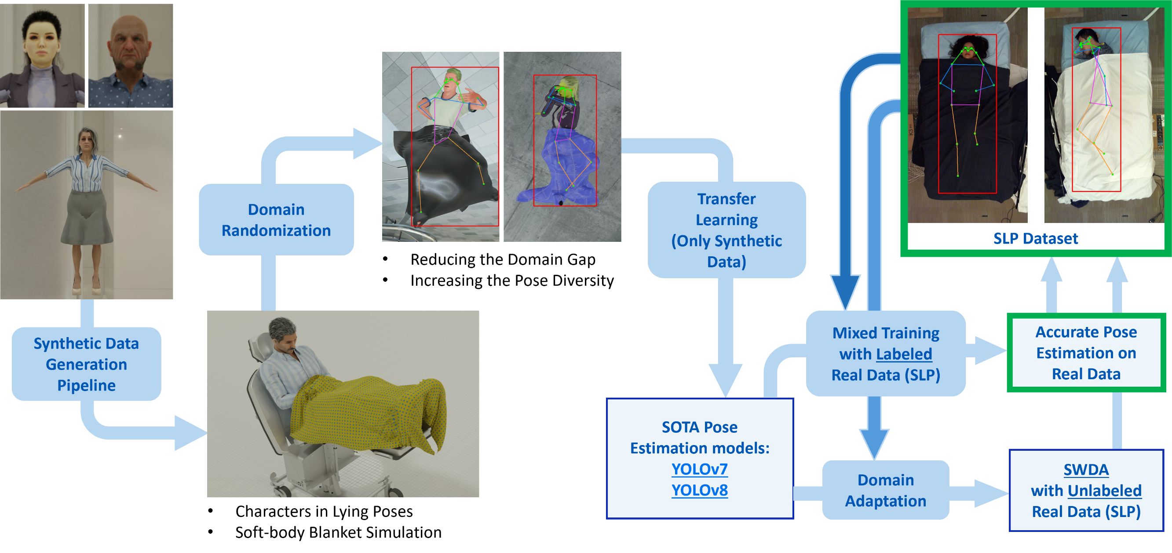
Master’s Thesis: Outline
Internship

Slide 4
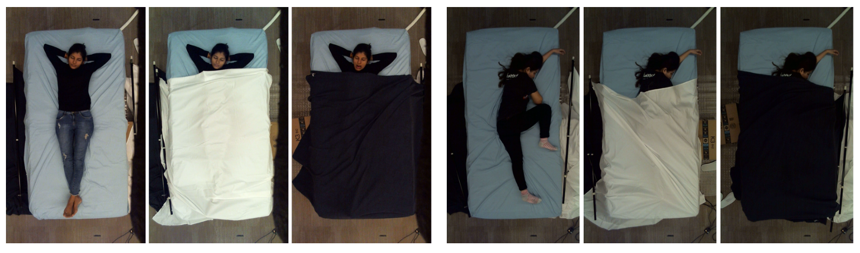
Real Dataset
Simultaneously-collected multimodal Lying Pose (SLP) dataset
109 participants: total 14715 samples
Overhead images in four modalities: RGB, LWIR, Depth, and Pressure Maps.
Three cover conditions: uncover, cover1 (≈ 1 mm thickness), cover2 (≈ 3 mm thickness).
uncover
cover1
cover2
uncover
cover1
cover2

Slide 5
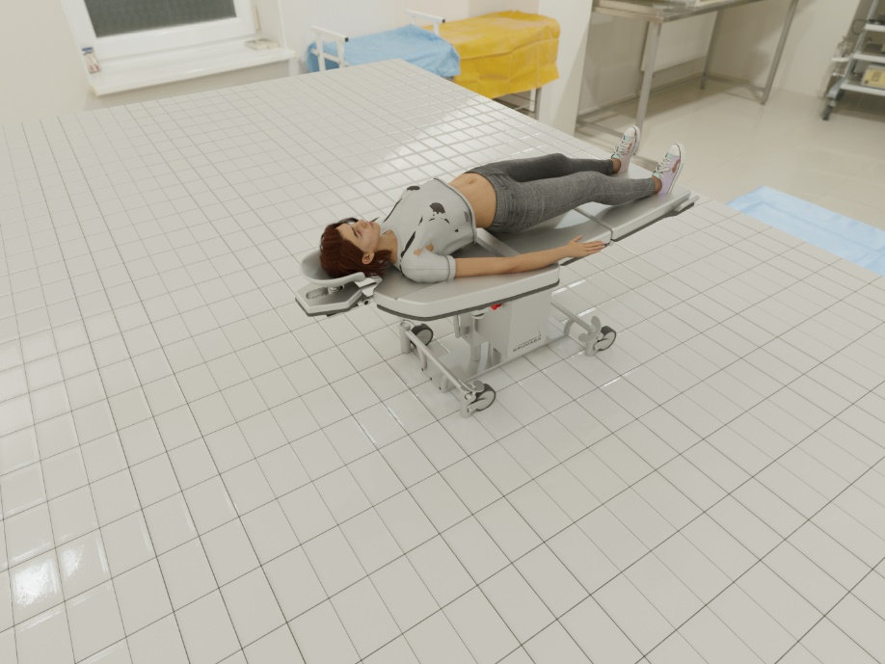
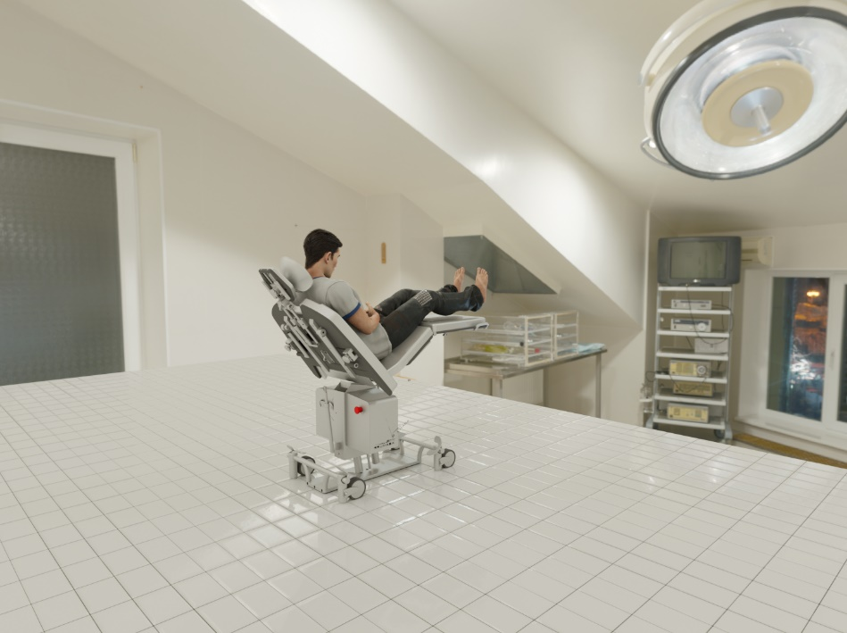
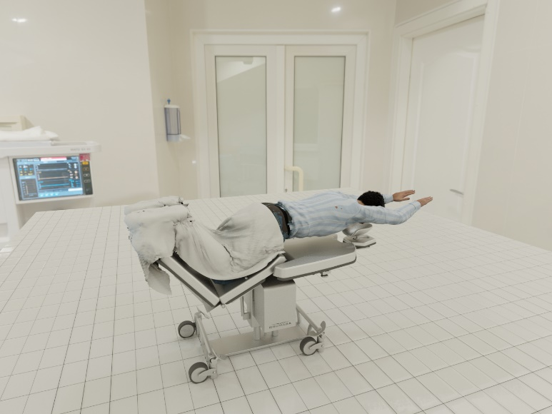
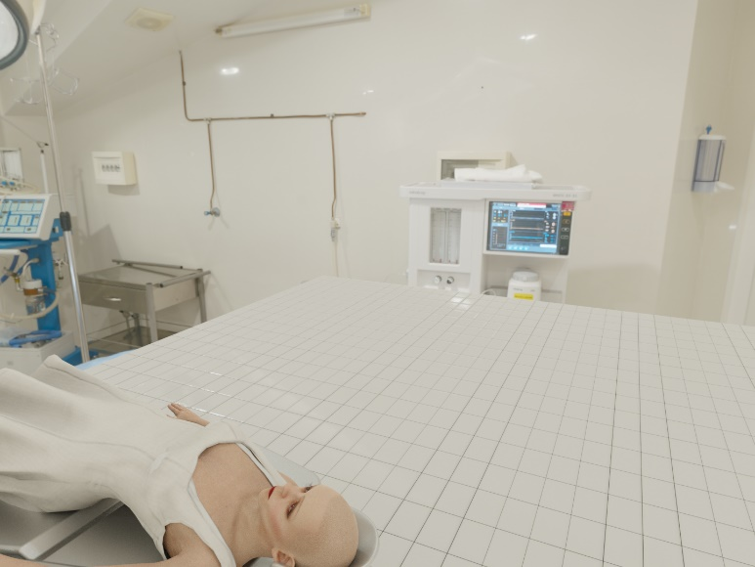
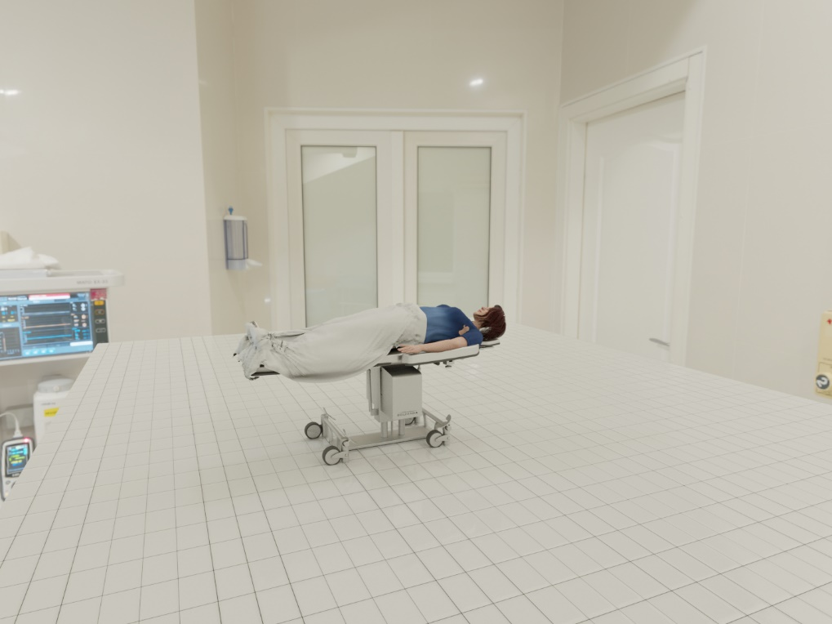
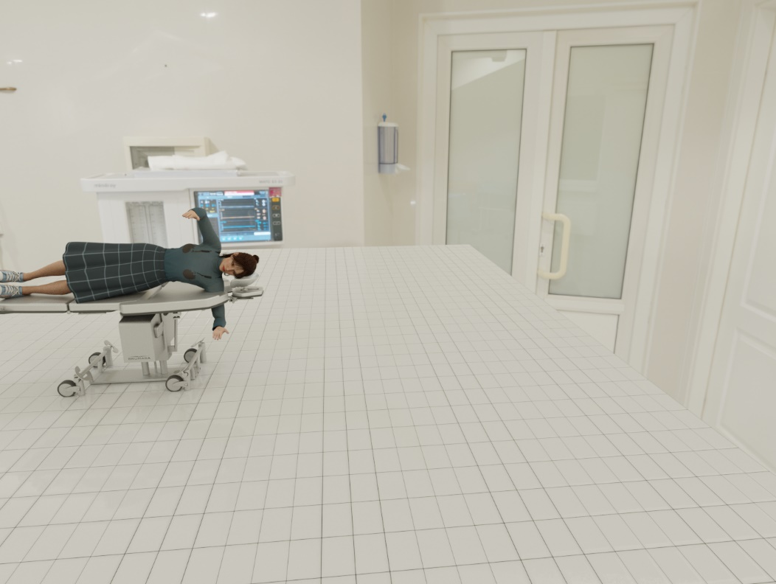
Previously Generated Synthetic Data

Slide 6
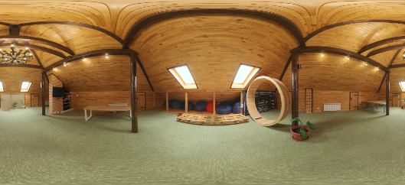
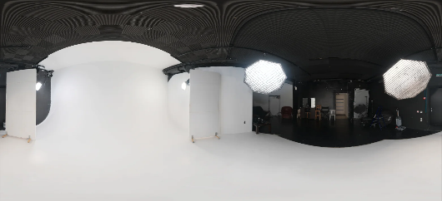
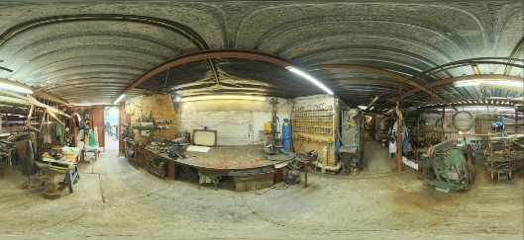
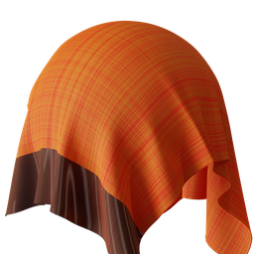
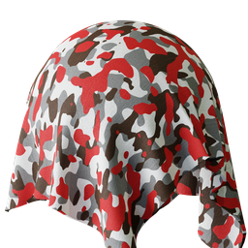
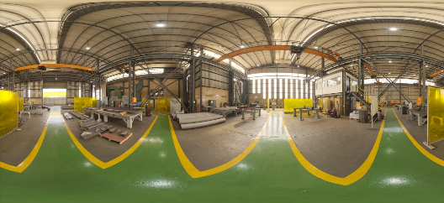
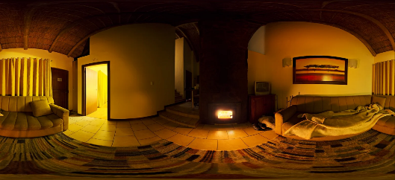
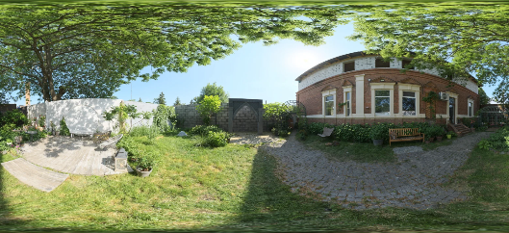
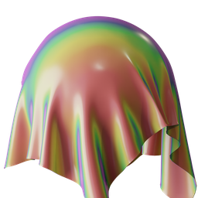
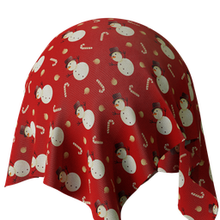
Adapting the Synthetic Dataset
Bridging the Reality Gap: Domain Randomization
Adding diversity in colors, textures, materials, and lighting.
HDRI Backgrounds: Random HSV values, light intensity, and orientation.
Blanket and Ground plane materials: diverse colors, roughness, reflectivity, patterns, and textures.
Characters hair, skin, and clothing: Random HSV values.
HDRI Backgrounds
Materials

Slide 7
Adapting the Synthetic Dataset
Increasing the Pose Diversity
Wider representation of the complex poses of humans under the cover.
Random joint angle variations
Every rotation joint is rotated by an angle along each axis in each frame of the scene.
The angle is uniformly sampled from a range of -5 to 5 degrees.
RealPose | RandPose
Base pose: Realistic poses created in previous work. Random joint angle variations with simultaneous blanket simulation. Less pose diversity than RandPose. | Base pose: Randomly generated. Specific rotation limits (human-like) for the joint angles were chosen for each axes. Base joint angles sampled from Uniform distribution. Random joint angle variations with simultaneous blanket simulation.

Slide 8
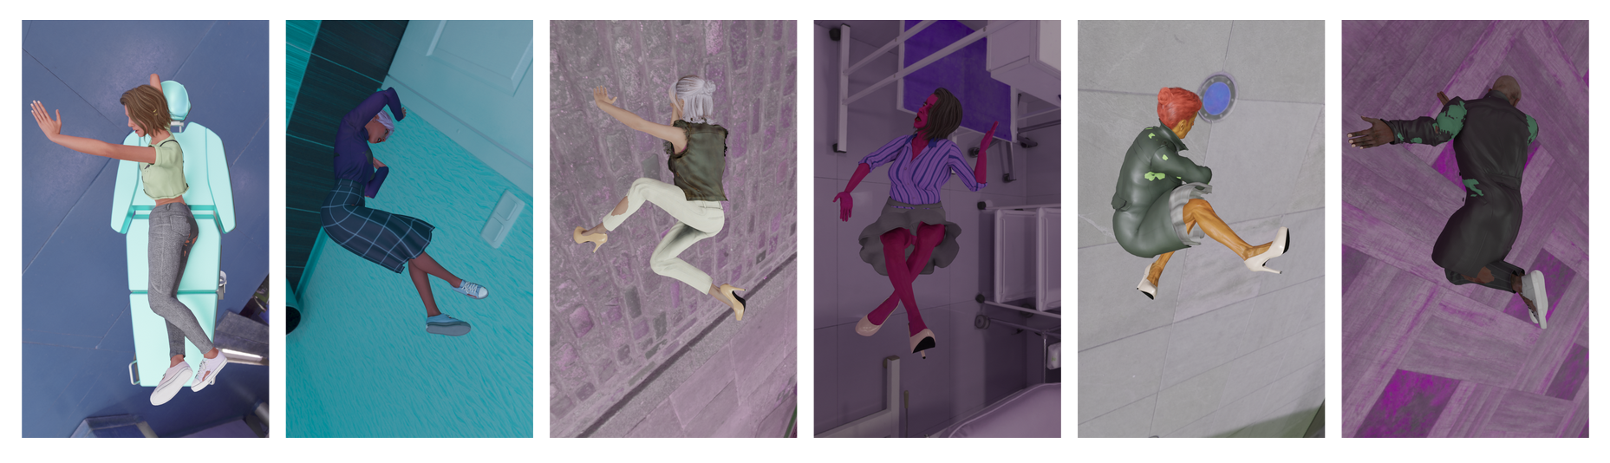
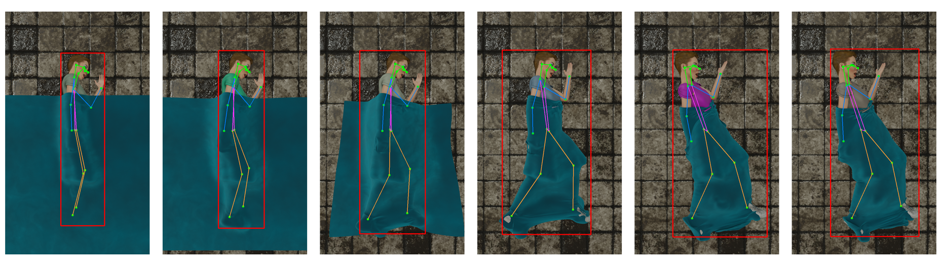
Adapting the Synthetic Dataset
Examples of the randomly generated base poses in the RandPose dataset
Random Joint angle variations

Slide 9
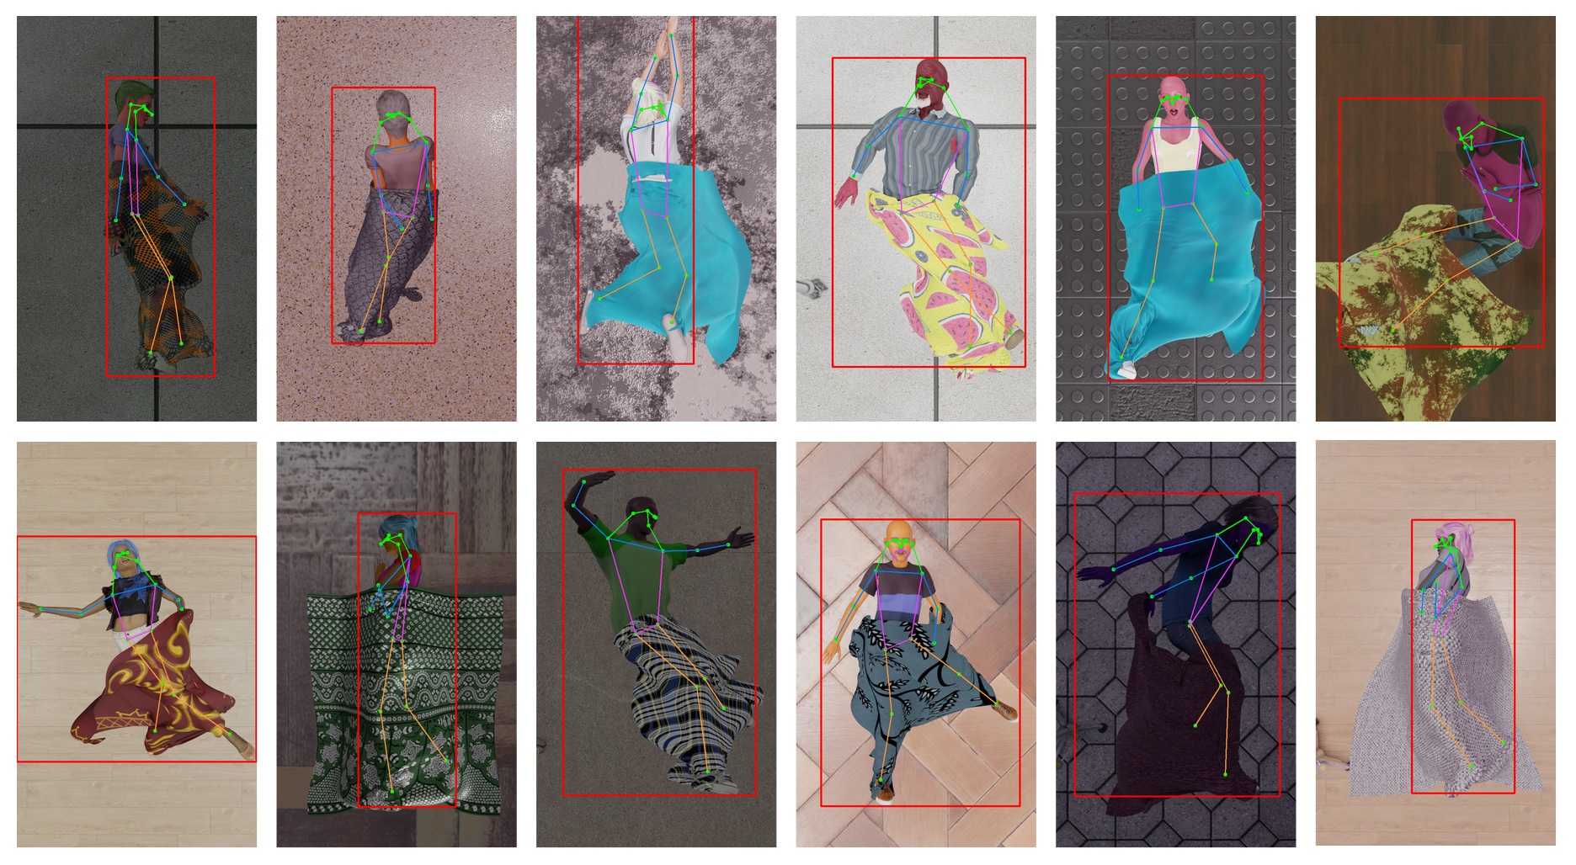
Examples from RealPose Dataset

Slide 10
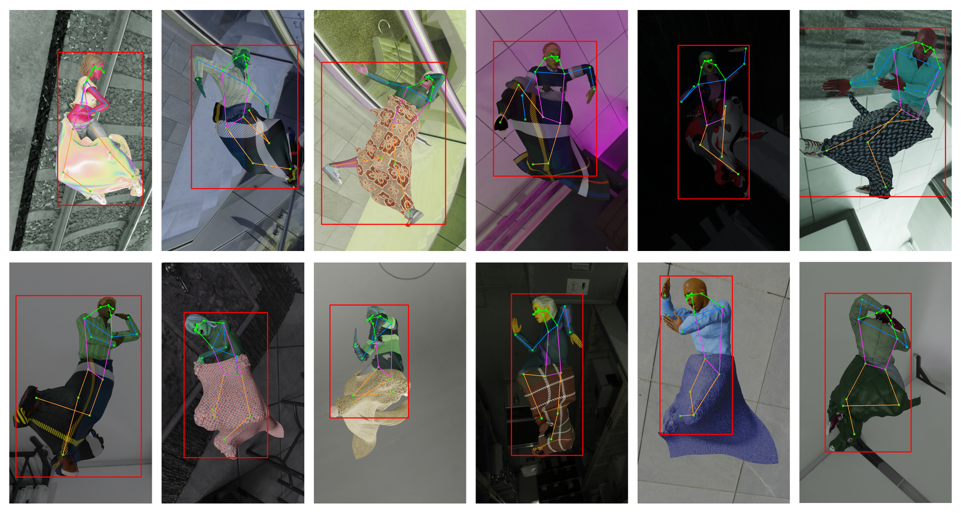
Examples from RandPose Dataset

Slide 11
Methodology
Experimental Setup
Models chosen for training: YOLOv7-pose and YOLOv8-pose
Real-time performance with less model complexity while maintaining a state-of-the-art accuracy.
Training Method: Transfer Learning
Retraining pre-trained models to tackle a related, but different problem by exploiting the knowledge gained from the previous task.
Evaluation Metric: OKS-based Mean Average Precision (Pose mAP₅₀ and mAP₅₀₋₉₅)
Dataset
Training set: Initially 100% synthetic data
Validation set: 50% Synthetic, 50% Real data in validation to better judge the performance of the retrained model.
Batch size: 16, Image size: 640

Slide 12
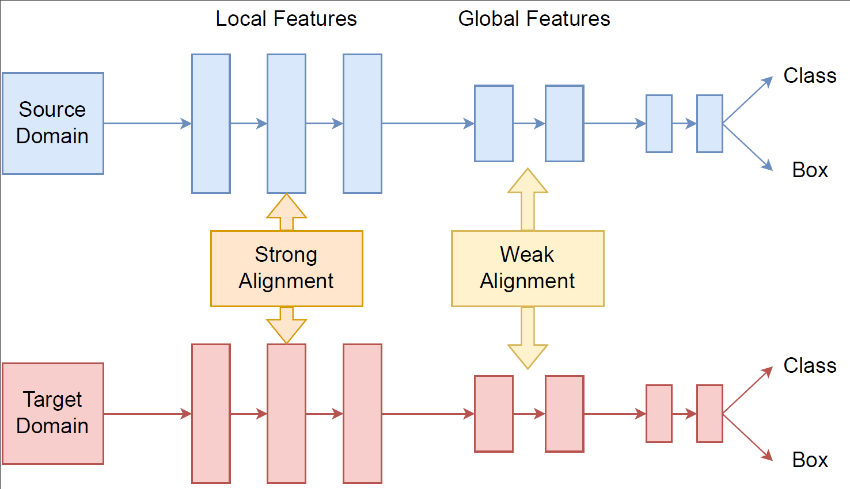
Methodology: Domain Adaptation with SWDA
Strong-Weak Distribution Alignment (SWDA) for object detection

Slide 13
Baseline: Performance of Pre-trained Models on the SLP dataset
YOLOv7-pose | YOLOv7 |  | RandPose
SLP set | Box mAP₅₀ | Box mAP₅₀₋₉₅ | Pose mAP₅₀ | Pose mAP₅₀₋₉₅
uncover | 1 | 0.993 | 1 | 0.882
cover1 | 0.00145 | 0.000264 | 0.361 | 0.0561
cover2 | 0.00444 | 0.00286 | 0.348 | 0.0546
YOLOv8-pose | YOLOv7 |  | RandPose
SLP set | Box mAP₅₀ | Box mAP₅₀₋₉₅ | Pose mAP₅₀ | Pose mAP₅₀₋₉₅
uncover | 0.995 | 0.995 | 0.995 | 0.891
cover1 | 0.0365 | 0.00848 | 0.424 | 0.0732
cover2 | 0.0466 | 0.0106 | 0.422 | 0.0728

Slide 14
Training with only Synthetic Data
YOLOv7
Pose mAP₅₀ | Pose mAP₅₀
SLP set | Pre-trained (Baseline) | RealPose | RandPose
cover1 | 0.361 | 0.743 (+38.2%) | 0.732 (+37.1%)
cover2 | 0.348 | 0.672 (+32.4%) | 0.696 (+34.8%)
cover1 + cover2 | 0.351 | 0.708 (+35.7%) | 0.711 (+36.0%)
Significant improvement over the pre-trained models
37% points for the cover1 set and 32% points for the cover2 set for Pose mAP₅₀.
The model can learn the pose representation of humans covered with a blanket from the synthetic data.
The model’s precision in estimating occluded keypoints still needs improvement.

Slide 15
Mixed Training: RealPose + Real Data (SLP)
YOLOv7
 | Pose mAP₅₀ |  |  | RandPose
SLP set | 0% Real Data | 10% Real Data | 5% Real Data | 2.5% Real Data | 1% Real Data
cover1 | 0.743 | 0.974 | 0.924 | 0.883 | 0.79
cover2 | 0.672 | 0.927 | 0.872 | 0.831 | 0.738
cover1 + cover2 | 0.708 | 0.941 | 0.899 | 0.858 | 0.764
No. of Real Images
1% = 5
2.5% = 12
5% = 25
10% = 50
Significant boost in accuracy with little real data
Higher precision in estimating occluded joints and extreme poses
Lesser domain gap

Slide 16
Mixed Training: RandPose + Real Data (SLP)
YOLOv7
 | Pose mAP₅₀ |  |  | RandPose
SLP set | 0% Real Data | 10% Real Data | 5% Real Data | 2.5% Real Data | 1% Real Data
cover1 | 0.732 | 0.974 | 0.948* | 0.913* | 0.865*
cover2 | 0.696 | 0.939* | 0.893* | 0.843* | 0.762*
cover1 + cover2 | 0.711 | 0.956* | 0.921* | 0.873* | 0.811*
No. of Real Images
1% = 5
2.5% = 12
5% = 25
10% = 50
Better performance in every score (indicated by a *) as compared to the RealPose dataset
1-7% points for Pose mAP₅₀
Higher pose extremity in the RandPose dataset was effectively learned and transferred to the SLP dataset

Slide 17
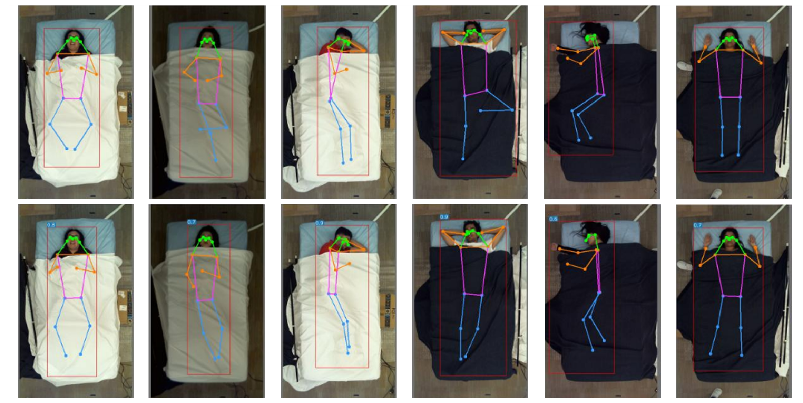
Qualitative results with Mixed Training (RandPose + 2.5% Real Data)
YOLOv7
Ground Truth
Predictions

Slide 18
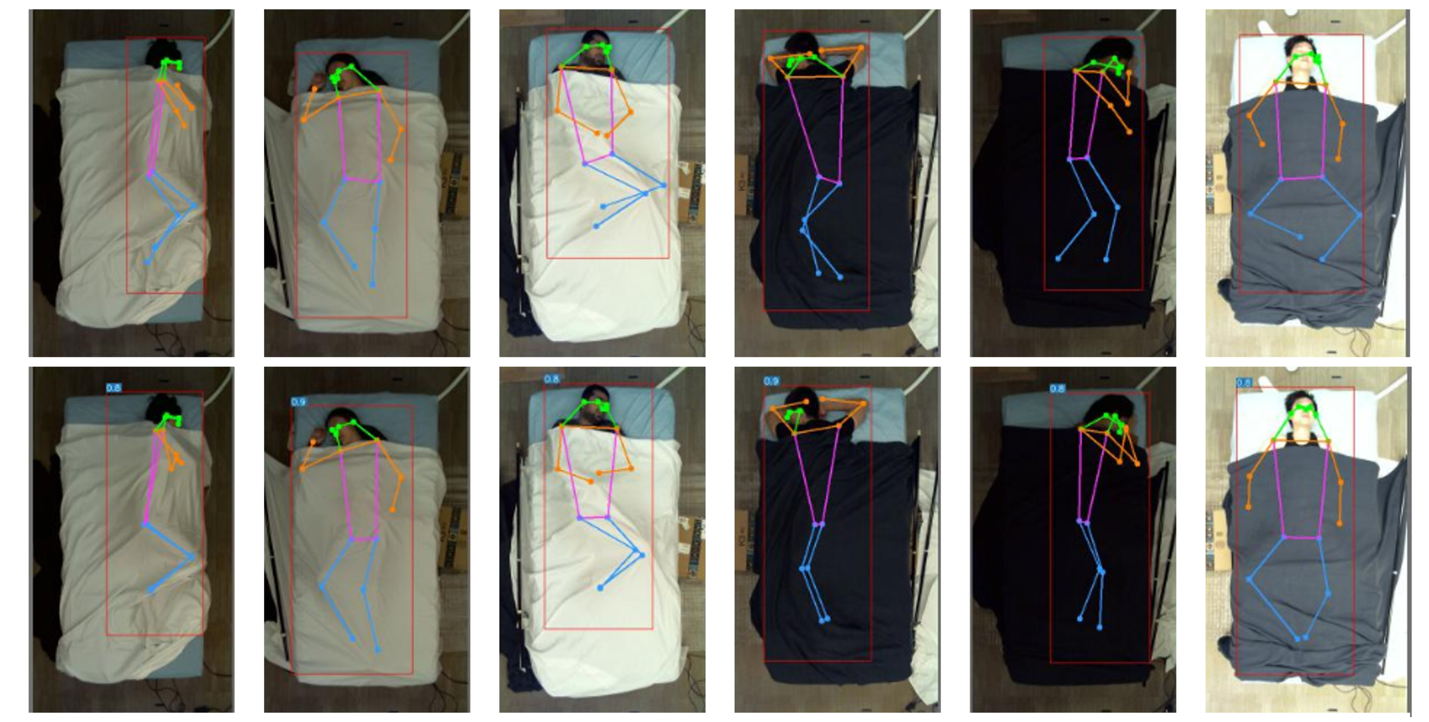
Qualitative results with Mixed Training (RandPose + 10% Real Data)
YOLOv7
Ground Truth
Predictions

Slide 19
Training with Domain Adaptation (SWDA)
YOLOv7
Pose mAP₅₀ | Pose mAP₅₀ |  | RandPose
 | RealPose |  | RandPose
SLP set | Without SWDA | With SWDA | Without SWDA | With SWDA
cover1 | 0.743 | 0.774 | 0.732 | 0.763
cover2 | 0.672 | 0.703 | 0.696 | 0.669
cover1 + cover2 | 0.708 | 0.732 | 0.711 | 0.714
Use of only unlabeled Real images
Steady improvement of around 3% with the RealPose dataset

Slide 20
Results Summary
YOLOv7
Pose mAP₅₀
RealPose | RealPose
SLP set | Pre-trained | With 100% Synthetic | 2.5% Real | 10% Real | Domain Adaptation
cover1 + cover2 | 0.351 | 0.708 | 0.858 | 0.941 | 0.732
RandPose | RandPose
SLP set | Pre-trained | With 100% Synthetic | 2.5% Real | 10% Real | Domain Adaptation
cover1 + cover2 | 0.351 | 0.711 | 0.873 | 0.956 | 0.714

Slide 21
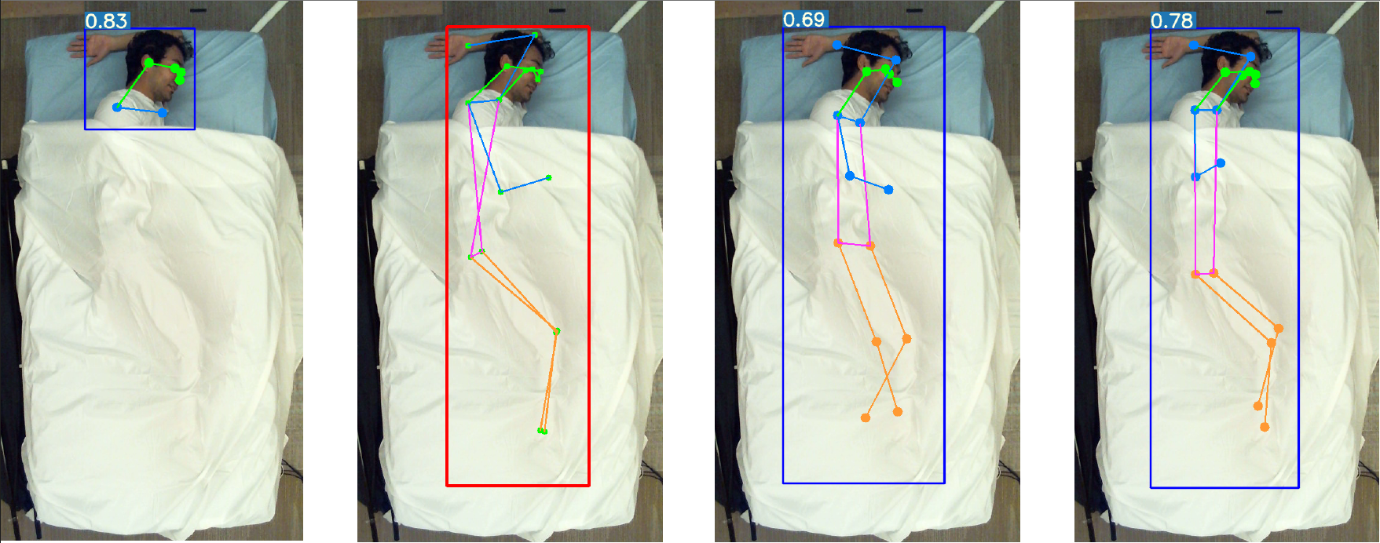
Results Summary: Qualitative Example
Pre-trained model
Ground Truth
Synthetic data and Domain adaptation
Mixed training with 10% real data

Slide 22
Conclusion
Retraining with synthetic data significantly increased the accuracy of the pre-trained model
Mixed training: Significant increase in accuracy with little real data
The RandPose dataset is the better dataset due to the higher representation of extreme poses
Transfer learning in combination with small-scale synthetic datasets can substantially reduce the dependence on large-scale real datasets
QnA

